Slide 1
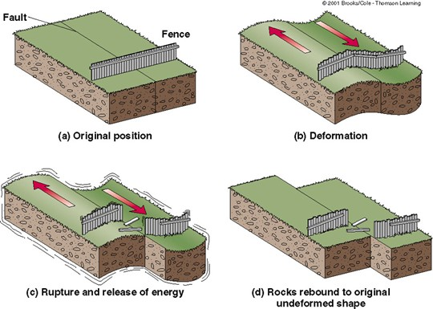
Daily Review
Vocabulary
fault: fracture or group of fractures in a block of rock
CFU 1
Explain the stick - slip motion of tectonic plates.
Plate tectonic stresses
When rock moves at plate boundaries and fault zones, there is friction.
They move in a STICK-SLIP motion; with p periods of no movement (stick) and fast movement (slip)
Energy is stored as plates stick and this energy is released when they slip.
CFU 2
Where does the energy released during an earthquake come from?

Slide 2
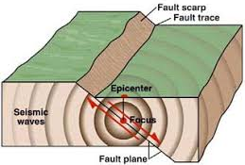
Daily Review
CFU 1
Explain the difference between the epicentre and the focus of an earthquake.
Anatomy of Earthquakes
The focus of an earthquake is the point within the Earth where the energy is released.
The point where the energy reaches the surface, directly above the focus is called the epicentre.
The waves of energy waves released are called seismic waves.
Vocabulary
seismic: relating to earthquake or other vibrations in the Earth.

Slide 3
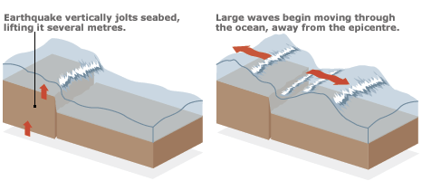
Daily Review
CFU 1
What events can trigger a tsunami?
Forming Tsunami
Disruption to the seafloor by earthquakes, volcanic eruptions or landslides can trigger a tsunami.
The movement of the seafloor displaces the water above it.
This forms large waves which radiate in all directions, similar to dropping a pebble into water.
CFU 2
How are tsunamis formed?
Vocabulary
displace: move something from its usual place or position.

Slide 4
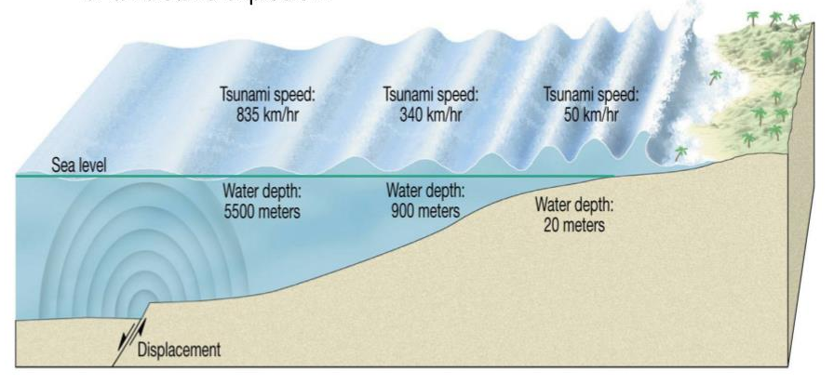
Daily Review
CFU 1
What happens to the height of the wave as a tsunami approaches shallow water?
Forming Tsunami
The waves travel towards land and increase in height as the depth of the ocean decreases.
In the open ocean, the energy from the earthquake is contained in a large volume water forming small waves.
When the wave enters shallow water, the energy is held by a smaller volume of water so the wave height increases
CFU 2
Explain why tsunami waves are small in open water and grow larger towards land.
Vocabulary
displace: move something from its usual place or position.

Slide 5
Volcanoes

Slide 6
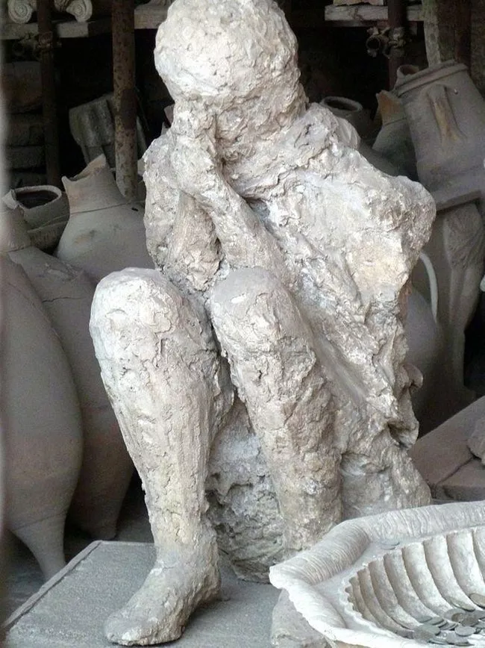
Learning Objective
CFU
What are we going to learn?
Identify key features of a volcano.
Explain the differences between different types of volcanoes.
Activate Prior Knowledge
The city of Pompeii was destroyed when Mount Vesuvius erupted in 79 A.D. When it was later excavated by archaeologists, many petrified (change to stony substance) human remains were discovered.
Think, Pair, Share: What caused humans to be petrified in Pompeii in Italy?

Slide 7
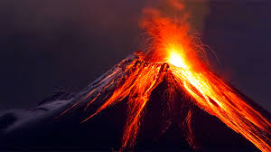
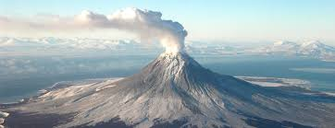
Concept Development
CFU 1
What are volcanoes?
Volcanoes
A volcano is a cone shaped mountain that opens downward to a pool of molten rock below the surface of the Earth.
Volcanoes erupt at convergent and divergent plate boundaries as well as at hot spots.
CFU 2
Where do volcanoes occur ?

Slide 8
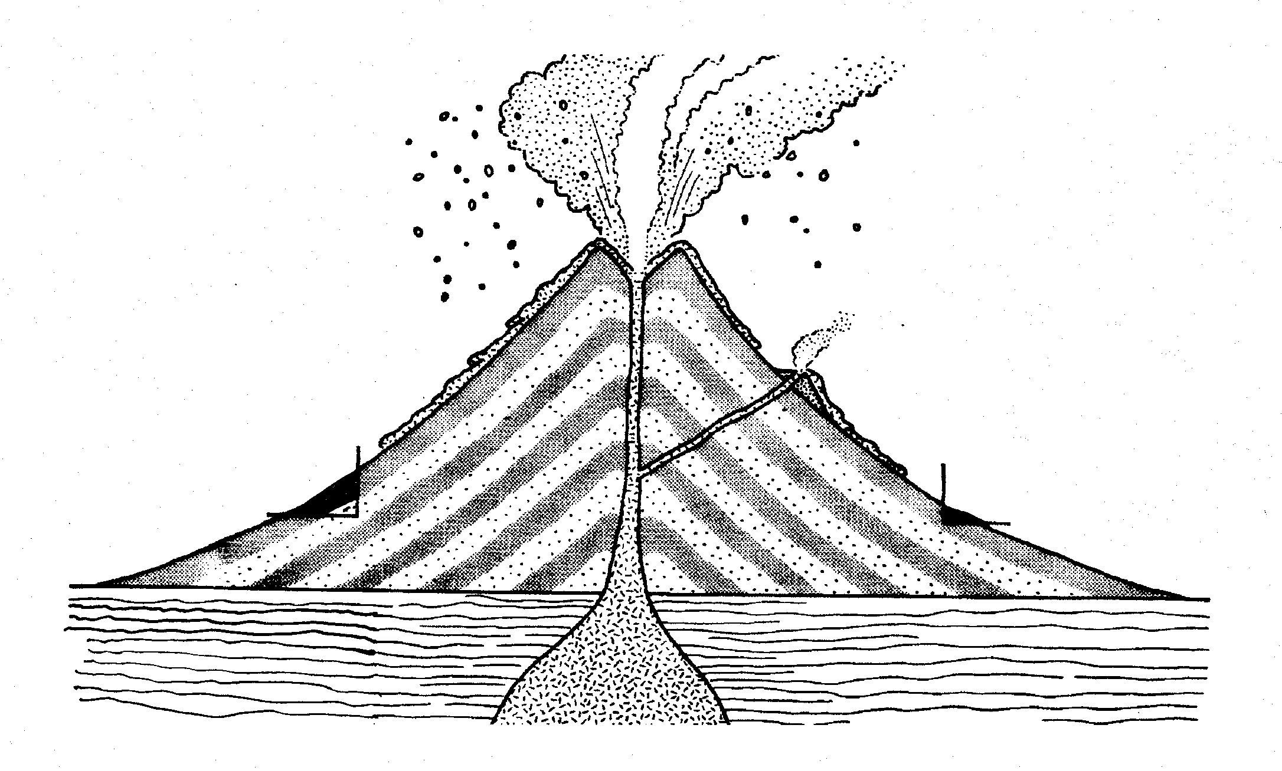
Structure of a volcano
Concept Development
Opening at the top of a volcano
CFU 1
How is a secondary vent different to the main vent?
Crater
Volcanic cloud
Gas, steam and ash escaping from the volcano
Large pieces of rock ejected from the volcano
Volcanic bombs
Allows magma to escape from the side of the volcano
Molten rock flowing down the side of the volcano
Secondary vent
Lava Flow
Cone
Tunnel through which magma rises to the top of the volcano
Main vent
Layers of ash and lava forming the volcano’s sides
CFU 2
List some materials that can be released from a volcano.
Magma Chamber
Store of molten rock beneath the volcano

Slide 9
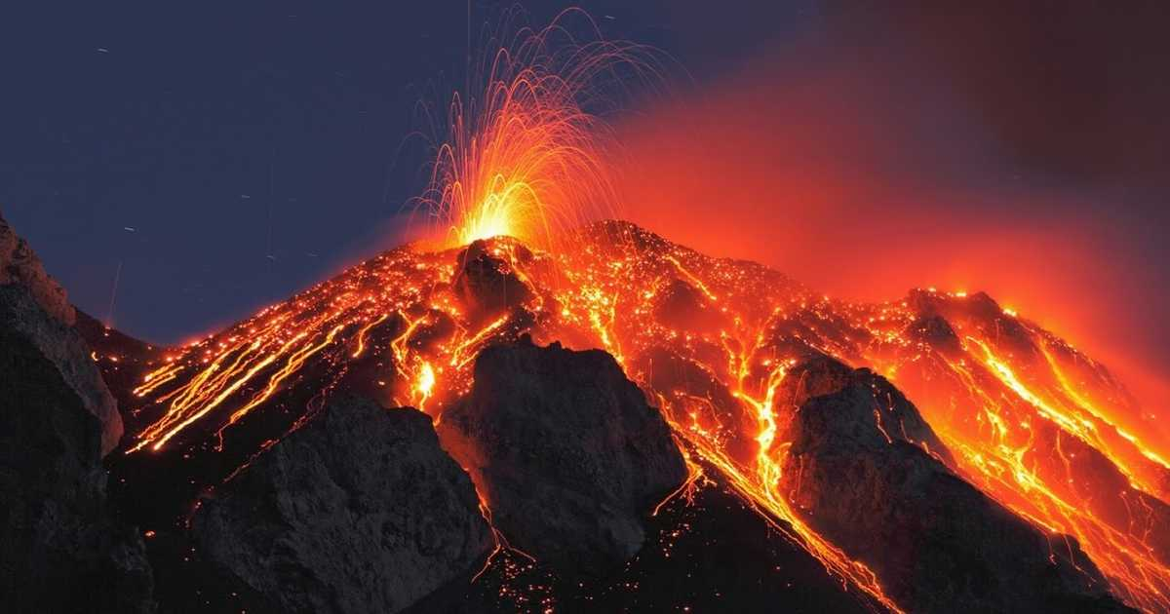
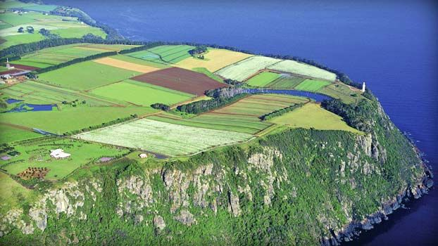
Concept Development
CFU 1
When is a volcano considered to be extinct?
Activity States of a volcano
Volcanoes can be described in terms of their activity.
Active volcanoes erupt frequently.
Extinct volcanoes are never likely to erupt again.
Dormant volcanoes are temporarily inactive, but not yet extinct.
CFU 2
Explain the difference between an active volcano and dormant volcano ?
Table cape in Tasmania is an extinct volcano

Slide 10
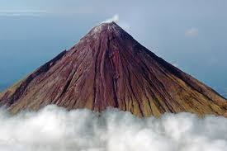
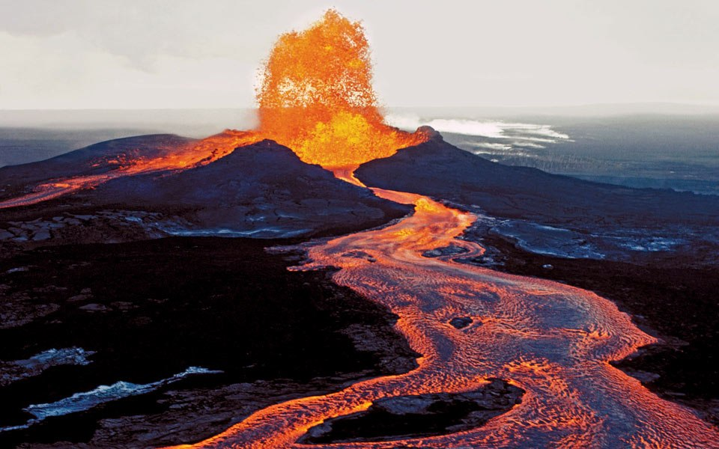
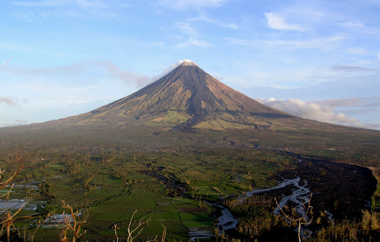
Concept Development
CFU 1
Explain how the viscosity of lava affects the shape of a volcano.
Shape of Volcanoes
The viscosity of the magma erupting from a volcano affects the volcano’s overall shape.
Magma that has low viscosity (it is runny) flows great distances and gives a gently sloping shape to the volcano.
Magma that has high viscosity (it is thick) flows slowly and creates a steeply sloping mountain shape to the volcano.
CFU 2
What type of lava formed the volcano below? Justify your choice.
Vocabulary
Viscosity: resistance of a liquid to a change in shape of movement

Slide 11
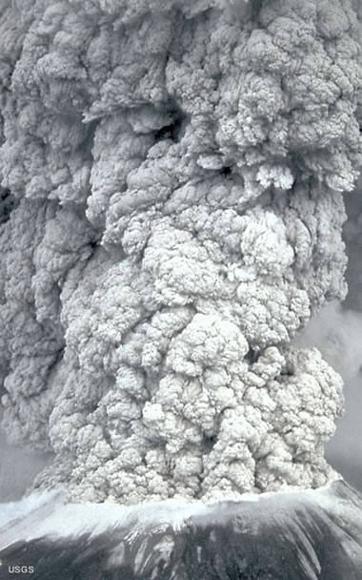
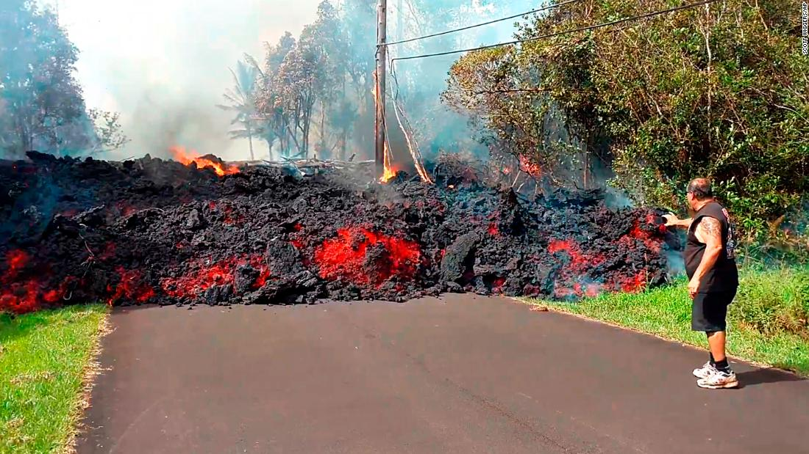
Concept Development
CFU 1
What is volcanic ash?
Damage Caused by Volcanoes
Volcanic ash is made from small, glass-like particles.
During heavy ash-rains, houses and buildings may collapse, people and animals may die by lack of oxygen.
Volcanic ash causes disruption to air traffic.
CFU 2
What sort of damage can be caused by volcanic ash?
Lava flows can damage buildings, roads, vegetation and city infrastructure

Slide 12


Slide 13
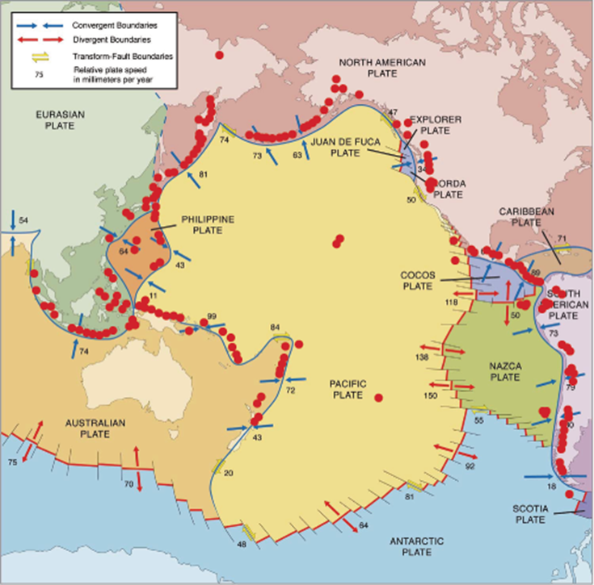
Concept Development
CFU 1
Explain the importance of the Ring of Fire?
CFU 2
What caused the Ring of Fire to form?
Pacific Ring of Fire
The Pacific Ring of Fire is an area around the pacific ocean that has approximately 450 volcanoes.
Over 75% of the world's active and dormant volcanoes can be found in this area.
The Pacific Ring of Fire is the result of tectonic plate movements.

Slide 14
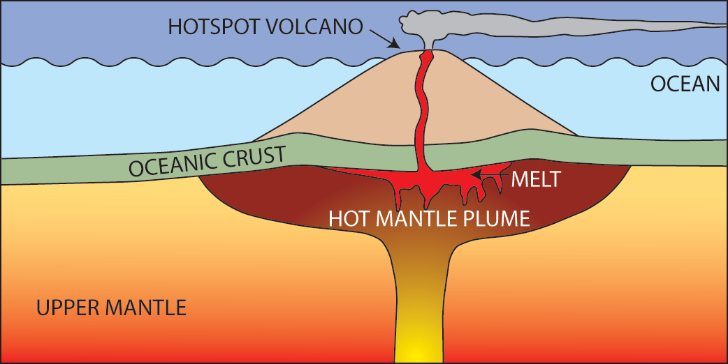
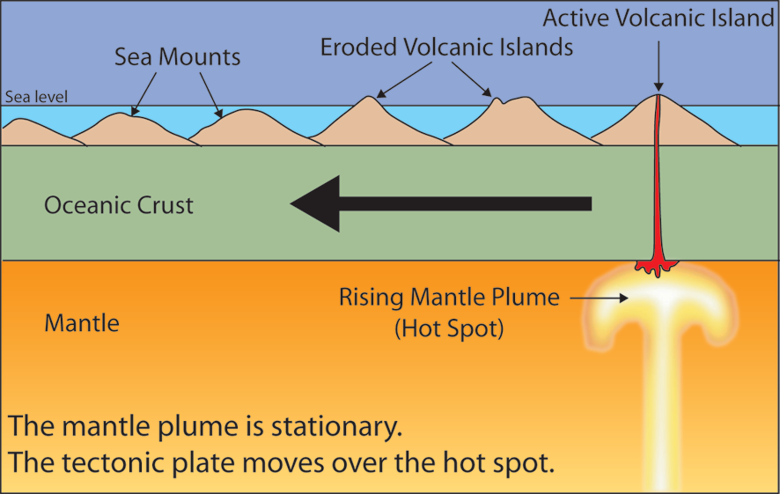
Concept Development
CFU 1
How does a hot spot cause a volcano?
CFU 1
What are volcanic hot spots?
Hot Spot Volcanoes
A hotspot is a an unusually hot part of the Earth’s mantle, which is relatively stationary.
These hot spots can result in large amounts of magma rising up, piercing a hole in the plate to form a volcano.
As the plates move above the hot spot, a series of volcanos can form.
This is how the Hawaiian Islands formed.

Slide 15
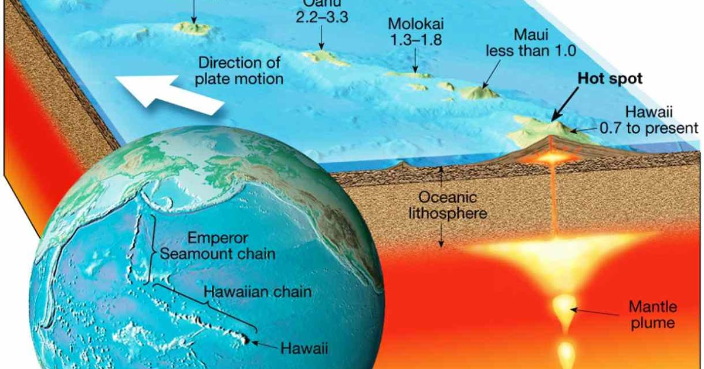
Concept Development
CFU 1
Explain how the Hawaiian chain of island were formed?
Hot spot volcanoes – Hawaiian Chain

Slide 16
On your volcano diagram, label the magma chamber. To the side or underneath your label, write what it is.
Skill Development/Guided Practice
Magma Chamber
Store of molten rock beneath the volcano

Slide 17
On your volcano diagram, label the main vent. To the side or underneath your label, write what they are.
Skill Development/Guided Practice
Tunnel through which magma rises to the top of the volcano
Main vent

Slide 18
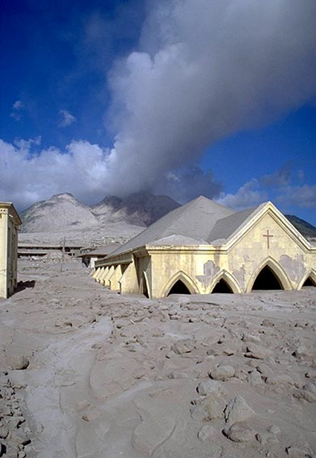
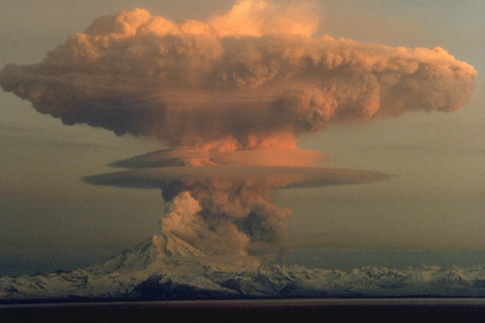
Skill Closure
Explain the damage that can be caused by a volcano.
Skill Closure
List the three activity states of a volcano, and explain what each one means.
Skill Closure
Explain how the Hawaiian islands formed.

Slide 19
Independent Practice
Finish the labels on the diagram and then answer the questions on the worksheet.
Opening at the top of a volcano
Crater
Volcanic cloud
Gas, steam and ash escaping from the volcano
Large pieces of rock ejected from the volcano
Volcanic bombs
Allows magma to escape from the side of the volcano
Molten rock flowing down the side of the volcano
Secondary vent
Lava Flow
Cone
Tunnel through which magma rises to the top of the volcano
Main vent
Layers of ash and lava forming the volcano’s sides
Magma Chamber
Store of molten rock beneath the volcano

Slide 20
Concept Development
Volcanoes
https://www.youtube.com/watch?v=8WsIqhkG8Ns

